Slide 1
Cosmetic eCommerce
Executive Presentation

Slide 2
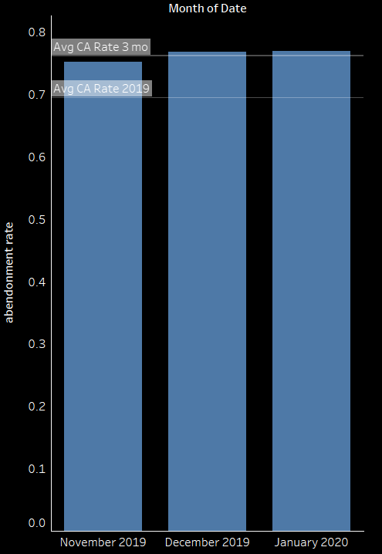
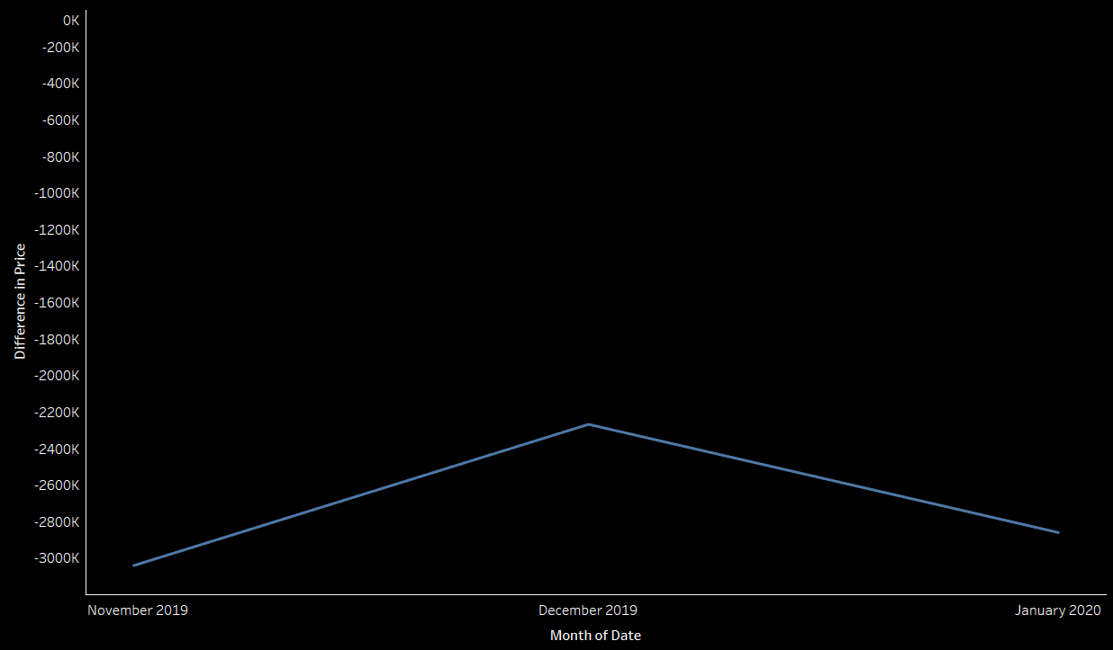
Decreasing the average cart abandonment rate from 76.2% during November 2019 and January 2020, to the global average rate of 69.6%, will decrease revenue loss by ~$300K, that will increase the average annual revenue by 37%.
Monthly Cart Abandonment
Monthly Revenue Loss From Cart Abandonment
$2.26M
$2.86M
$3.04M
Source: Kaggle - eCommerce Events History in Cosmetics Shop (November 2019 – January 2020)

Slide 3
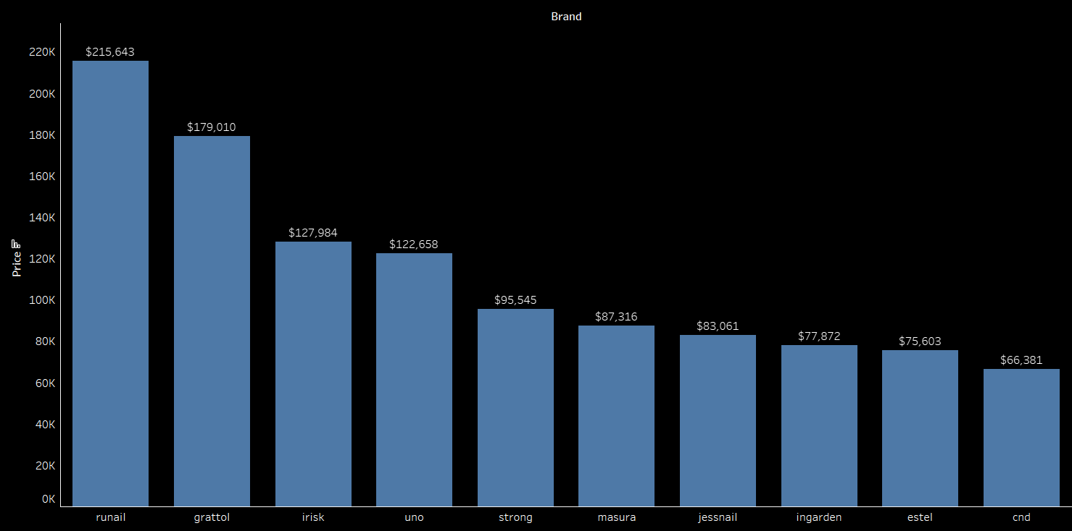
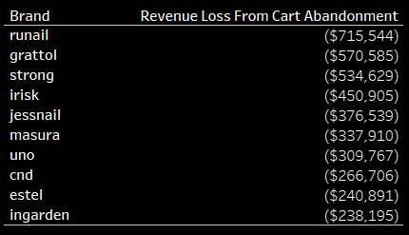
Further analysis reveals that the top ten selling brands are also the top contributors to revenue loss due to cart abandonment.
Top 10 Selling Brands and Their Total Revenue
Source: Kaggle - eCommerce Events History in Cosmetics Shop (November 2019 – January 2020)

Slide 4
Analysis performed to help determine brand restructuring to decrease cart abandonment rate, has shown that by removing brands with average cart abandonment rate greater than 80%, the company will increase it’s revenue by almost $5M. Removing brands with an average cart abandonment greater than 85% will increase revenue by ~$800K.
Source: Kaggle - eCommerce Events History in Cosmetics Shop (November 2019 – January 2020)

Slide 5
Thank You!

